Slide 1
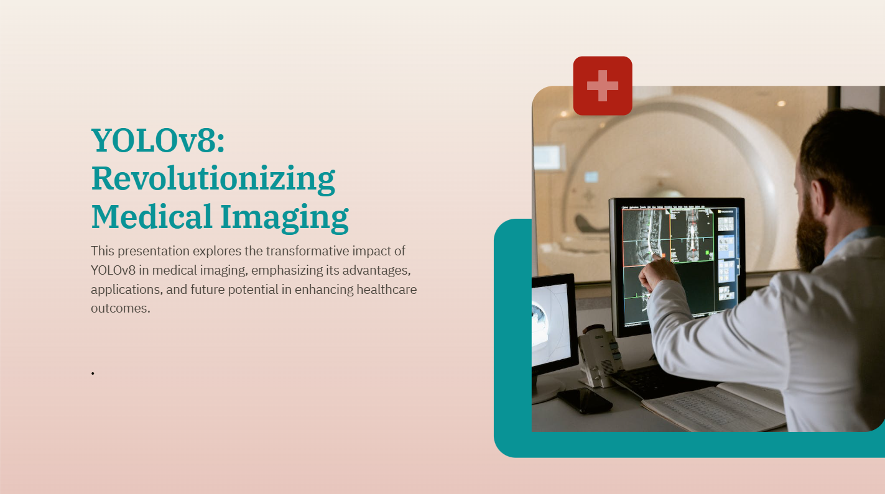
Babar Ali – 051
Muhammad Taqui – 021
Hermen Khan - 054
Github Repo: https://github.com/itaqiz/YOLOv8_Medical_Imaging

Slide 2
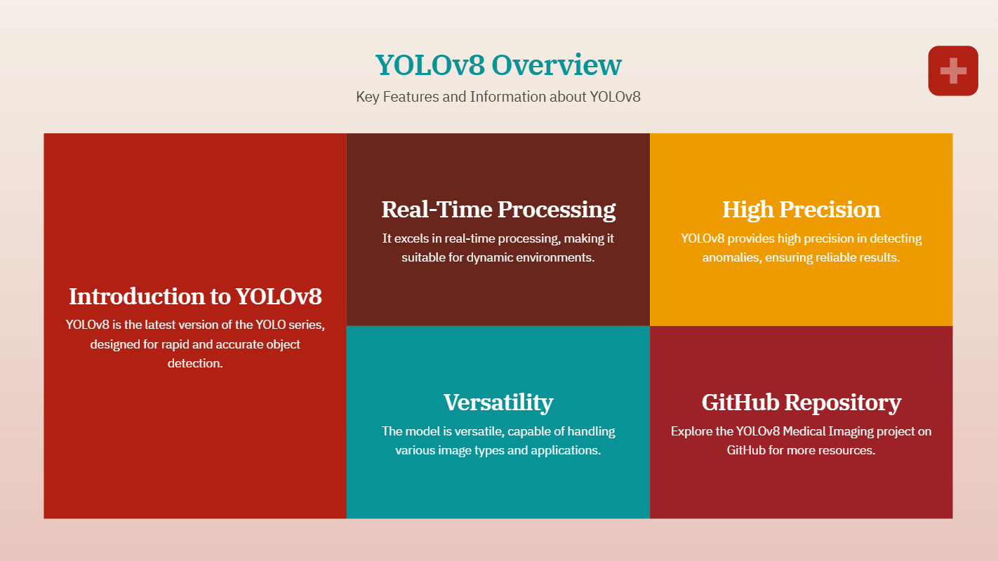

Slide 3
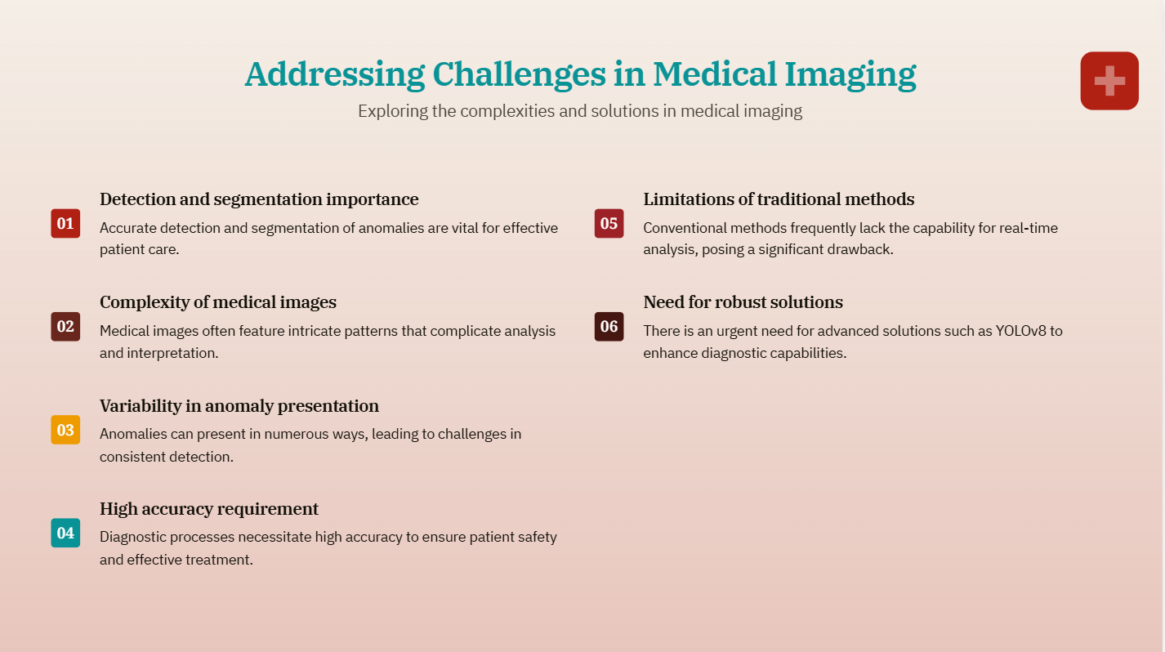

Slide 4
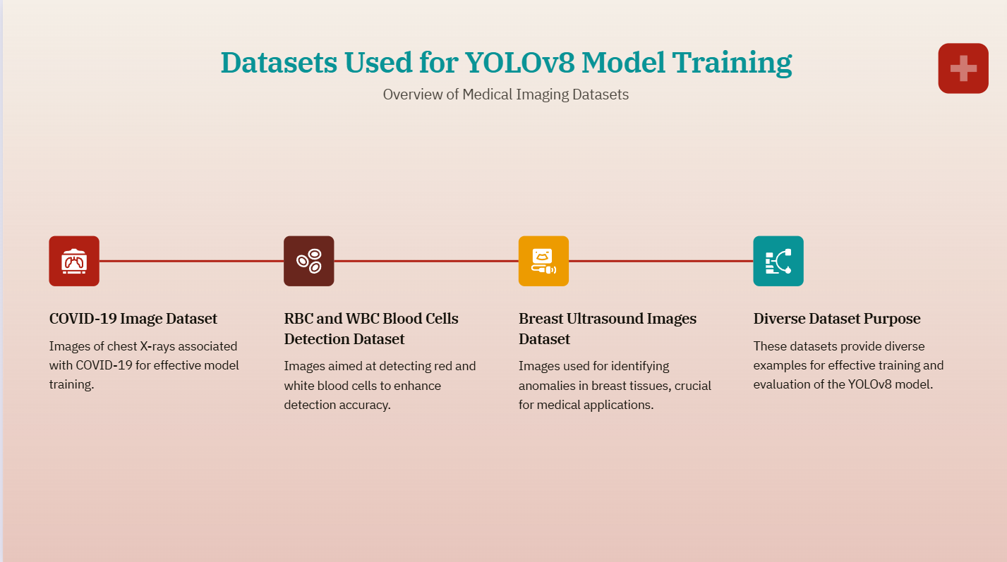
https://www.kaggle.com/datasets/pranavraikokte/covid19-image-dataset
https://universe.roboflow.com/tfg-2nmge/yolo-yejbs
https://www.kaggle.com/datasets/aryashah2k/breast-ultrasound-images-dataset

Slide 5
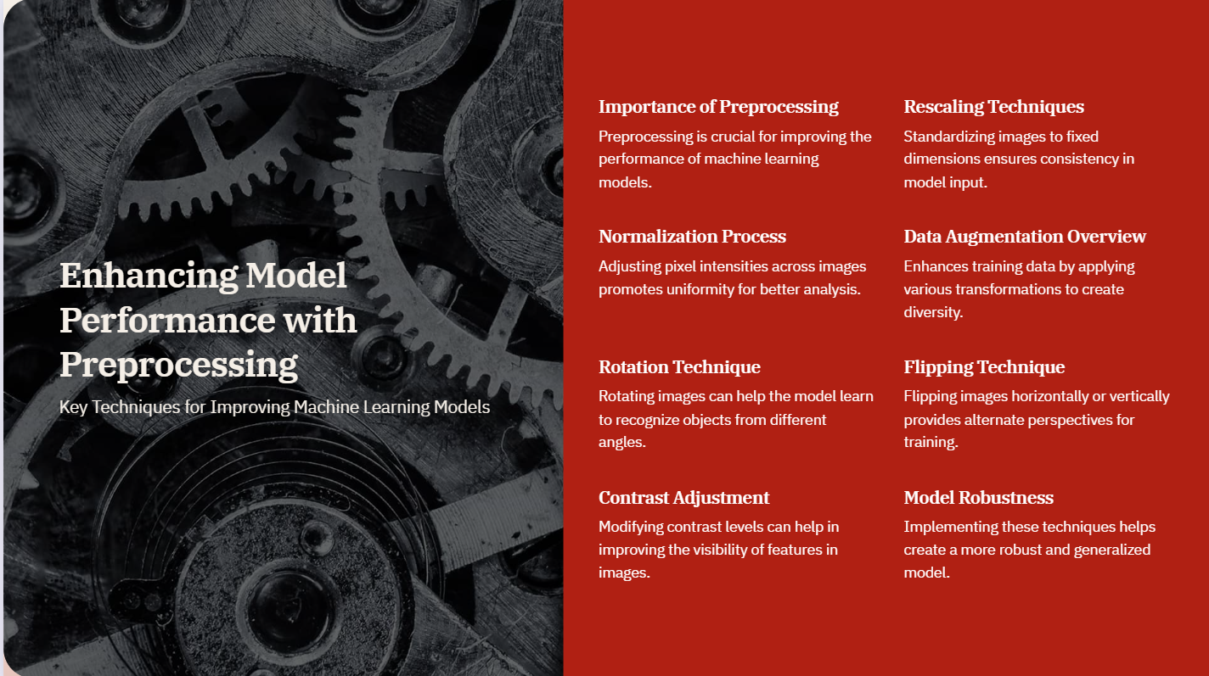

Slide 6
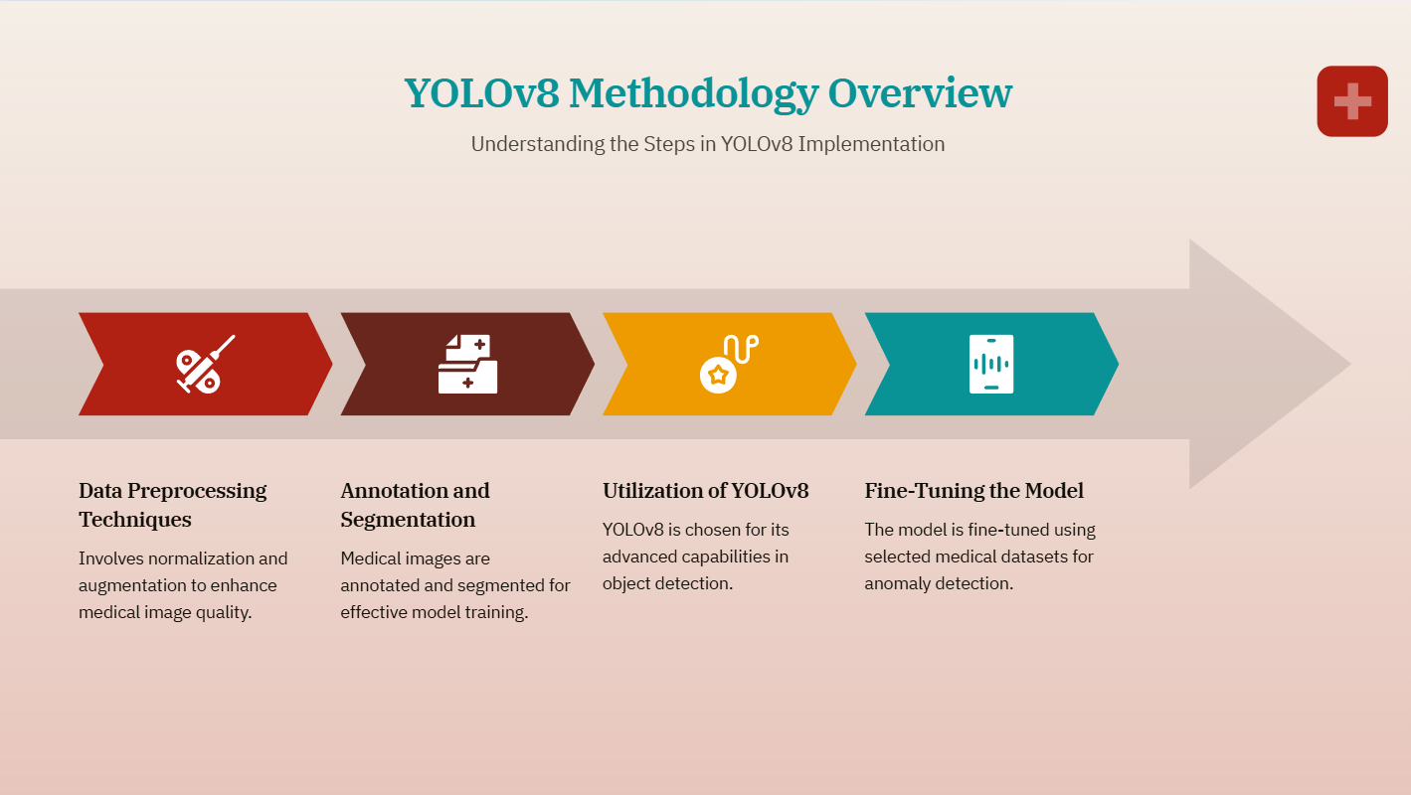

Slide 7
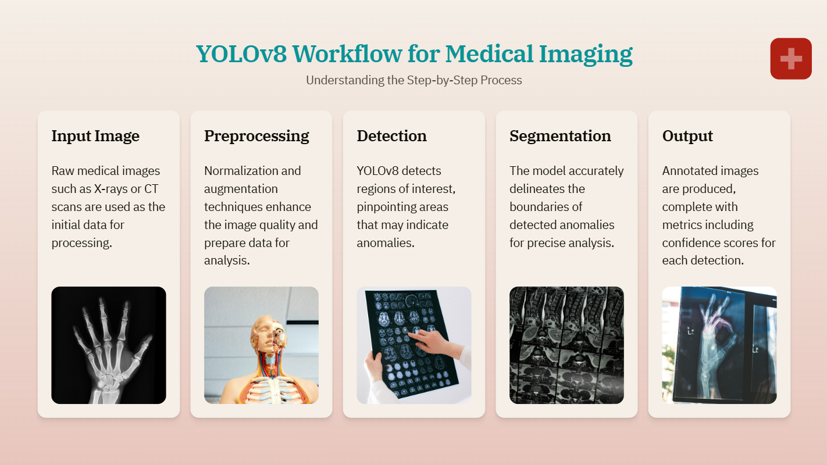

Slide 8
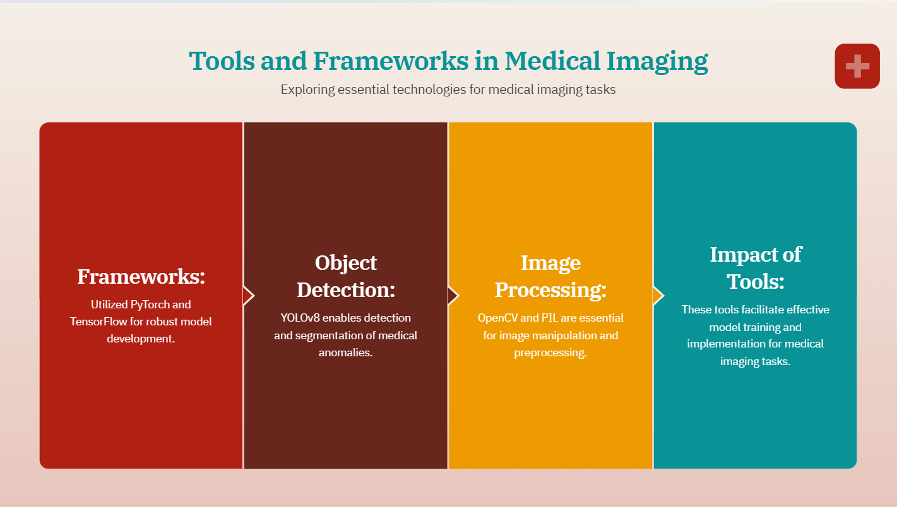

Slide 9
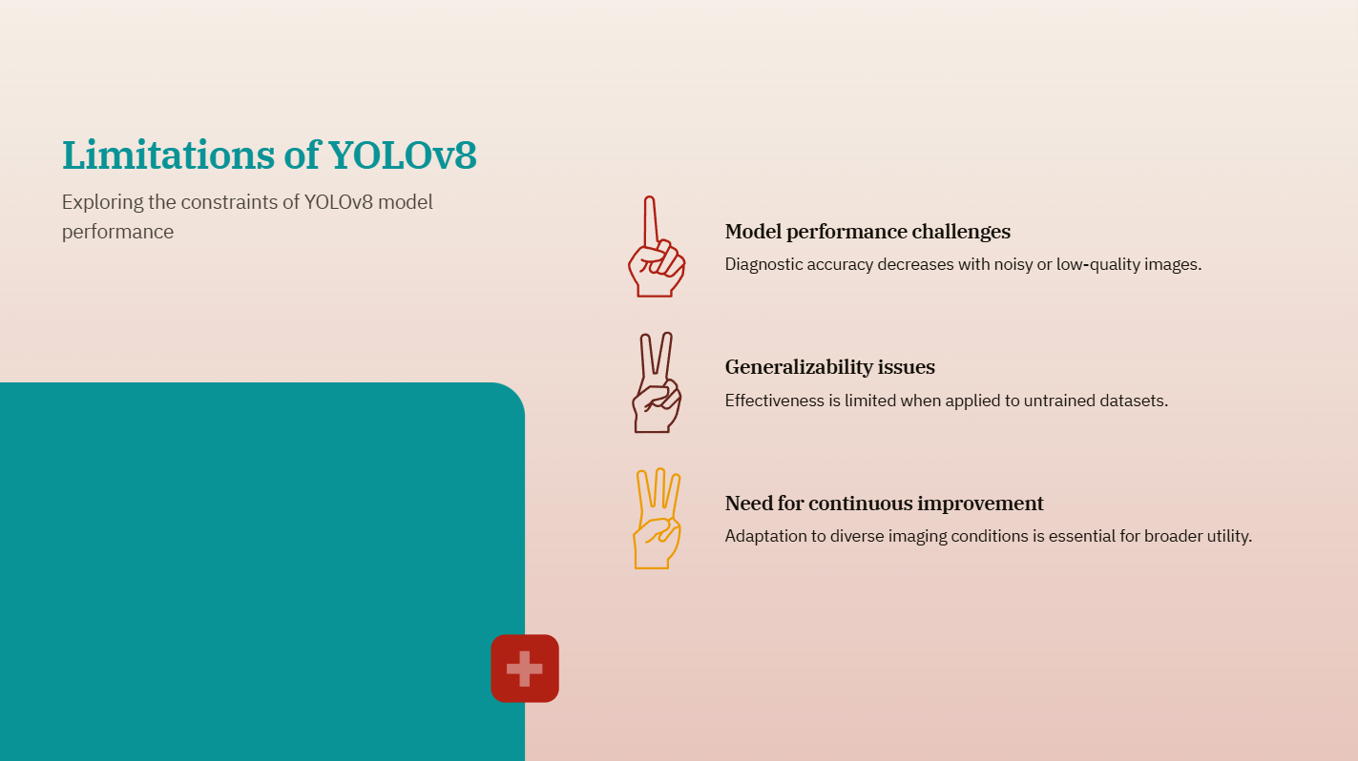

Slide 10
